Slide 1
ANALYSIS OF MINIMAX ALGORITHM USING TIC-TAC-TOE

Slide 2
CONTENTS
Introduction
Proposed Framework
Brute Force approach
Minimax approach
Conclusion
Implementation
Reference

Slide 3
INTRODUCTION
2 player game
One player chooses ‘O’ and the other ‘X’ to mark their respective cells.
The game ends when one of the players has one whole row/ column/ diagonal filled with his/her respective character (‘O’ or ‘X’).
If no one wins, then the game is said to be draw.

Slide 4
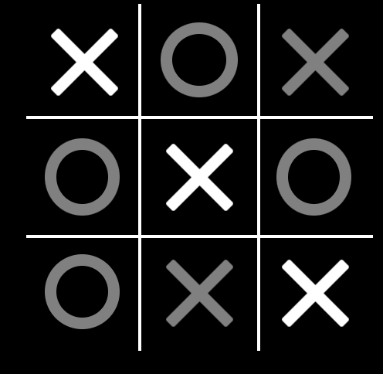
TIC-TAC-TOE
AI based algorithms can be implemented for such games, but need an optimal solution is on arise.
We require a comparative analysis of multiple algorithms for understanding the most efficient and ideal one.

Slide 5
Proposed FRAMEWORFKS
Brute Force Approach
Minimax Approach

Slide 6
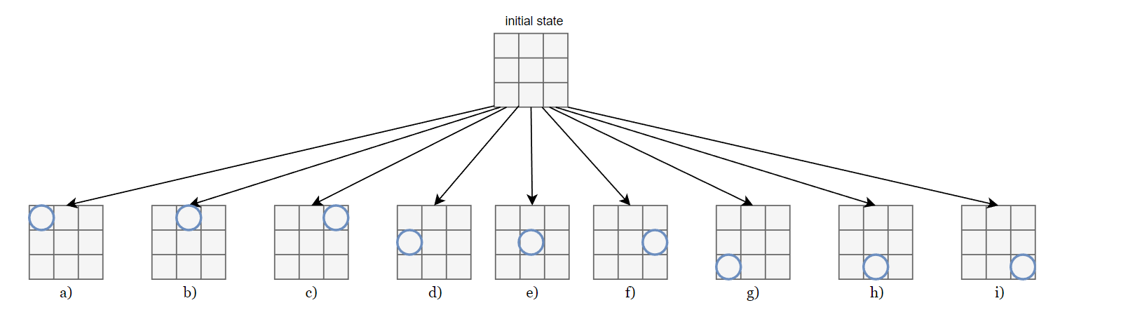
Brute Force APPROACH
At the very beginning of the game, a player can choose any of the 9 available empty spaces
For each of these 9 possible states we can create 8 new arrows to a new state

Slide 7
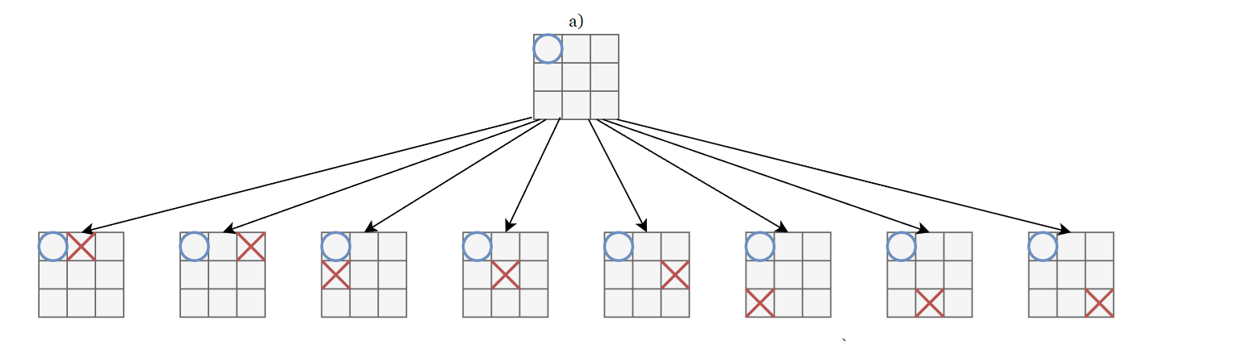
Brute Force APPROACH

Slide 8
Hence, we have:
first action: 9 states
second action: 9×8 = 72 states
third action: 9×8×7 states
…
last action: 9! =362880 states
So, in total we have:
9!+(9×8×⋯×2)+(9×8×⋯×3)+⋯+(9×8) + 9 = 986409 possible states
Finding the right solution by this method consumes a lot of time.

Slide 9
MINI MAX APPROACH
Minimax is a kind of backtracking algorithm that is used in decision making and game theory to find optimal move for a player, assuming opponent also plays optimally.
The player need to fulfil two condition to win a game
- Maximize the chance to win the game
- Minimize the opponent’s winning chance.
For max player select the child with maximum score
For min player select the child with minimum score

Slide 10
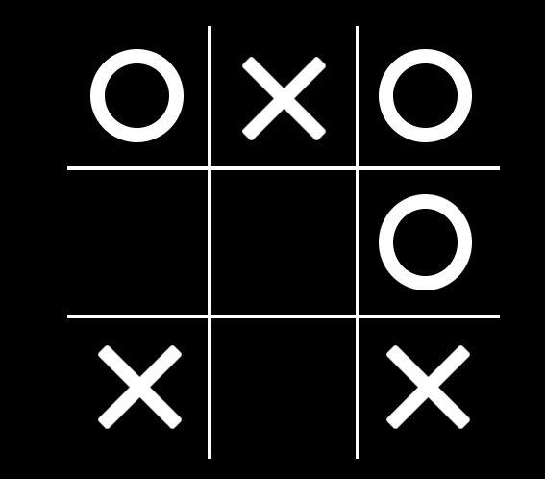
We are going to represent the problem as a search tree along with some additional information, ie,
Heuristic function = X’s possibility to win – O’s possibility to win
X’s possibility to win O’s possibility to win
When value of heuristic is >= 1, X has highest possibility to win
When value of heuristic is=0, highest possibility to draw
When value of heuristic is negative, O has highest possibility to win

Slide 11
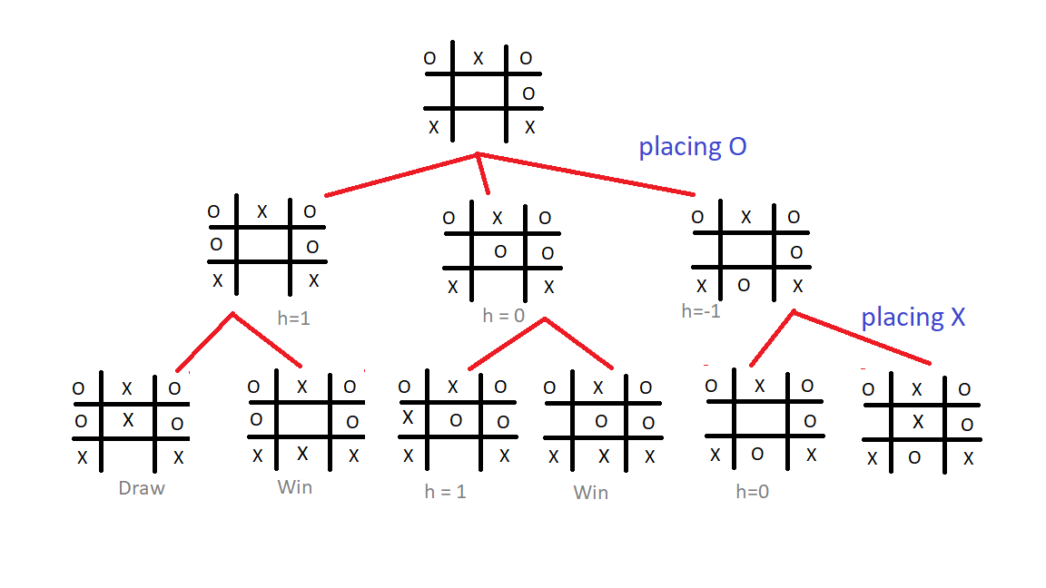
Search Tree
Mini max algorithm can be improved using Alpha Beta pruning

Slide 12
ALPHA BETA PRUNING
Alpha – Beta pruning - it remove all nodes that are not really affecting final decision but makes algorithm slow. Hence by pruning these nodes , it makes algorithm faster.
Alpha – highest value we found so far at any point along the path of maximiser.
Initial value - -infinity
Beta – lowest value we found so far at any point along the path of minimiser.
Initial value - +infinity
Alpha-Beta pruning allows the space to be used in a compact manner as well as use time efficiently

Slide 13
CONCLUSION
The result in the Minimax is better than brute force .
Minimax and Alpha Beta pruning algorithm have good talent in giving a great performance for Tic-Tac-Toe game

Slide 14
implementation
I am planning to implement the Tic-Tac-Toe game using Minimax approach.

Slide 15
REFERENCE
https://www.researchgate.net/publication/346813363_Analysis_of_Minimax_Algorithm_Using_Tic-Tac-Toe

Slide 16
THANK YOU

